Slide 1
SPIRIT PODS
INTRO TO 3D – REED AND WIRE UNIT

Slide 2
Art Problems
- Problem
- Conceptualize
- Explore Medium
- Plan
- Translate into 3D form
- Document work
- Reflect
Notes:
Given problem, must come up with solution that meets all parameters in creative and personal way.
Plan how they will achieve their solution/goal.
Translate notes and 2D drawings into a 3D work.
Document findings, successes, failures, changes, etc.
Reflect

Slide 3
SPIRIT PODS
Spirit - the nonphysical part of you that is the seat of your emotions and character; your soul.
Utilizing the expressive potential line has to offer, you will give form to your spirit. You will create a pod using wire and/or reed that utilizes line, space, and form to visually represent your spirit.

Slide 4
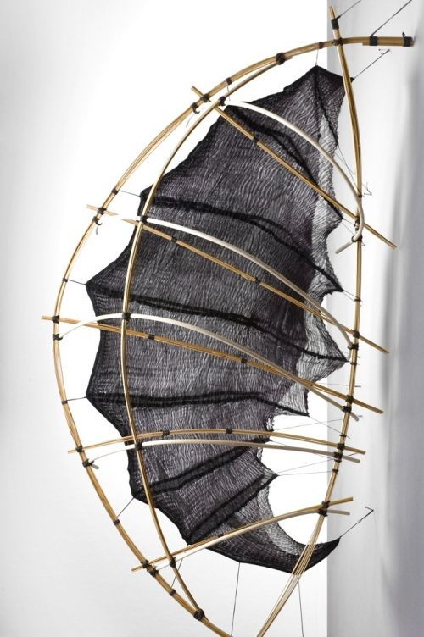
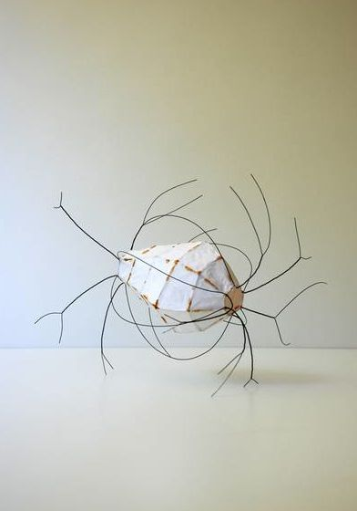

Slide 5
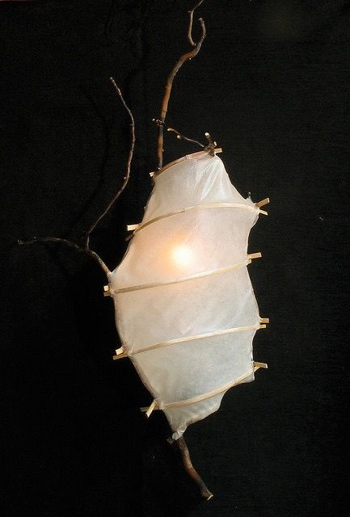
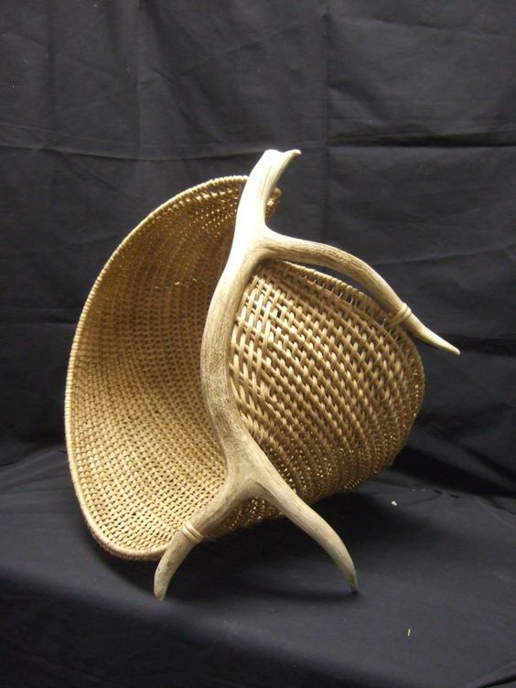

Slide 6
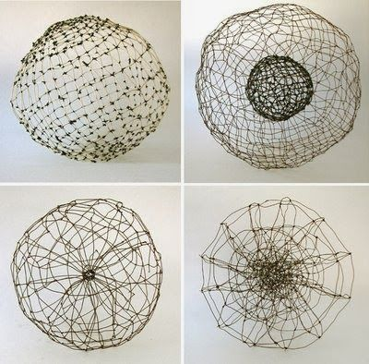
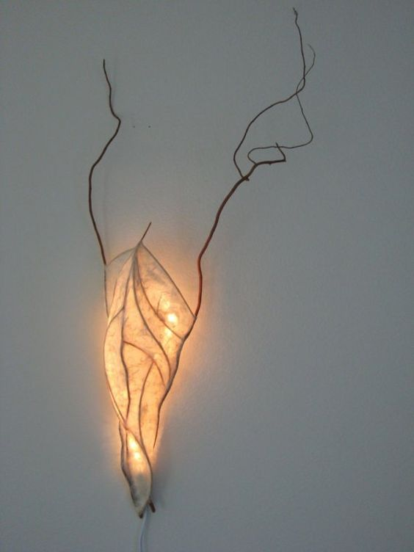

Slide 7
LINE
A continuous mark made on a surface by a moving point. This element is used to define space, contours, and outlines, or suggest mass and volume.

Slide 8
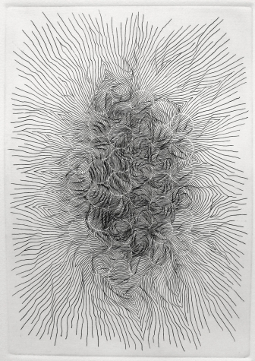
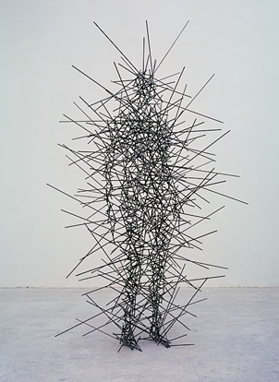
Multiple lines can be grouped together to create a tone or a sense of volume.

Slide 9
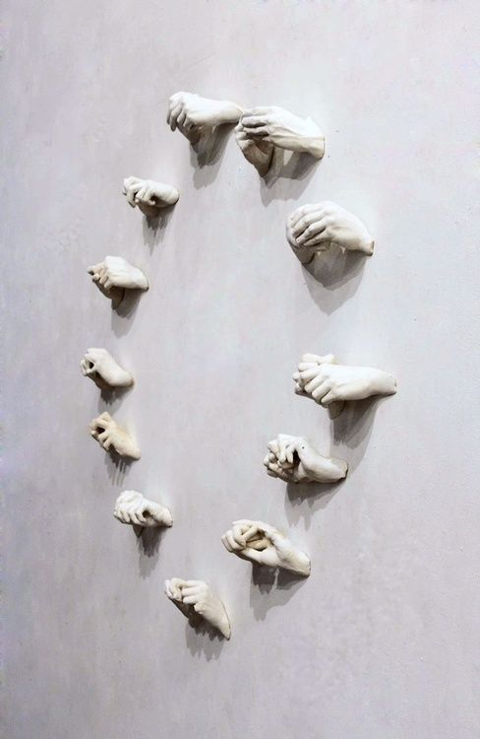
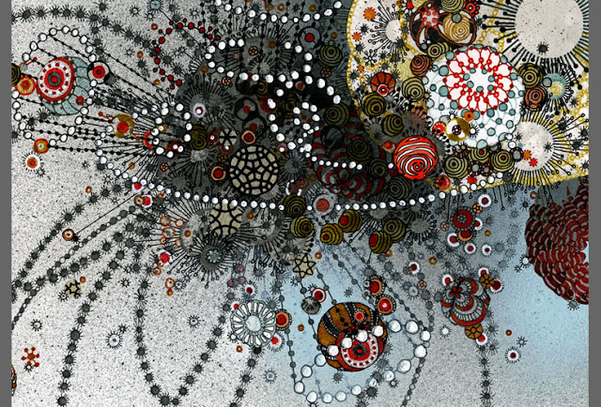
Line can also be implied. An implied line is a non-continuous line that seems to be continuous, like a series of dashes; ---------- or - - - - - - - - - - or - - - - - - - - - - and so on

Slide 10
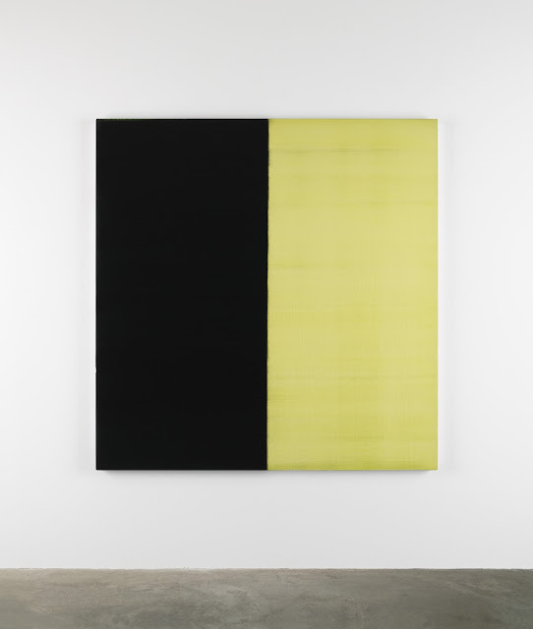
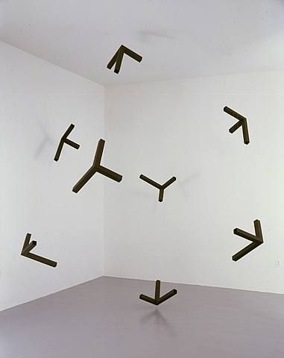
Implied lines are also lines that may not have been explicitly drawn, but the composition makes it appear that they are there.

Slide 11
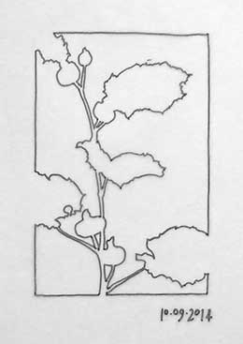
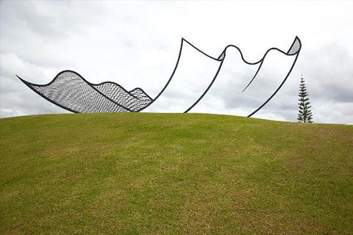
Space- Distance around, between, above, below, or within an object.
Negative Space – The areas of an artwork not occupied by subject matter, but which contribute to the composition.
Positive Space – The areas containing the subject matter in an artwork.

Slide 12
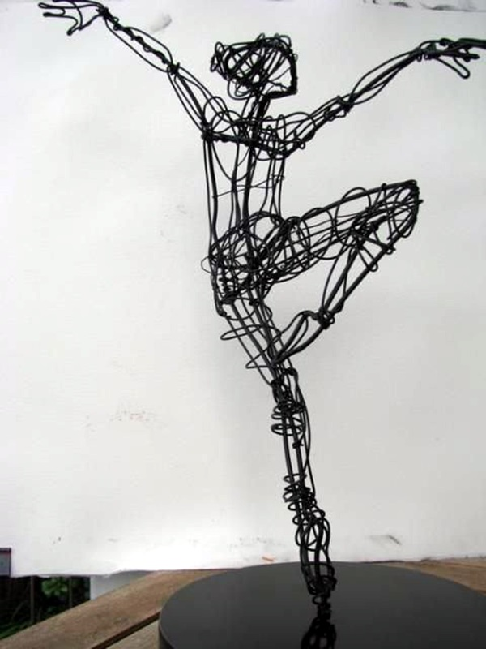
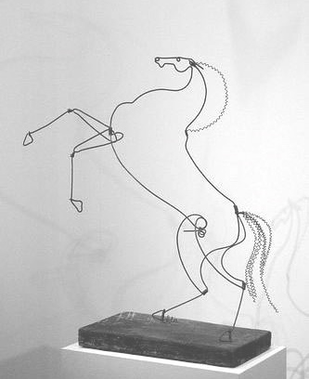
Contour lines are lines that describe a shape and/or form of a figure or object and also include interior detail.
Gesture- an energetic type of line that catches the movements and gestures of an active figure.

Slide 13
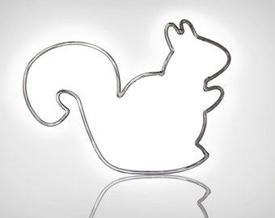
Outline- A line that defines the outer edge of a silhouette/ line made by the edges of an object.

Slide 14
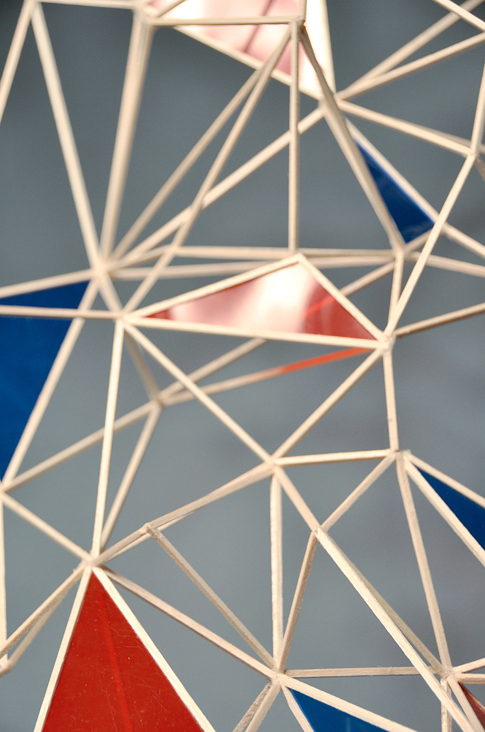
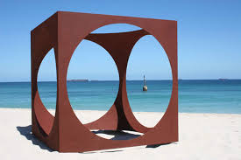
Shape- element of design that is two-dimensional and encloses area.
Form- an element of design that is three-dimensional & encloses volume.

Slide 15
EXPLORING
THE MEDIUM: WIRE AND REED

Slide 16
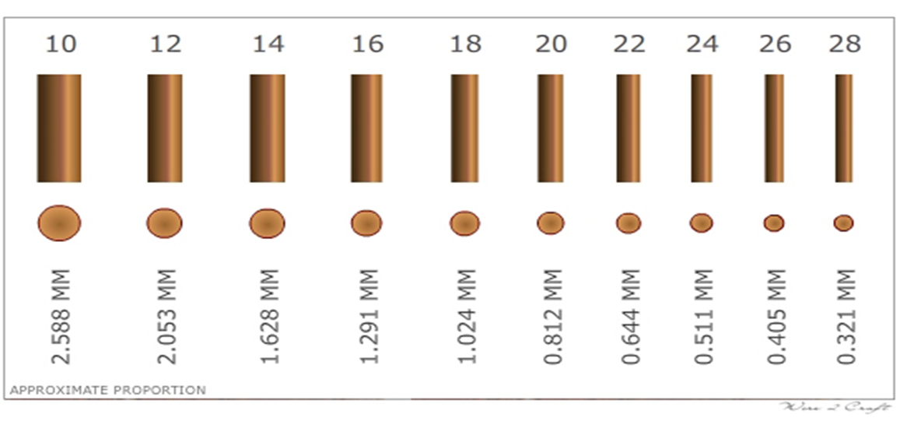
WIRE
A usually pliable metallic/steel strand made in many lengths and diameters (gauges).
Anneal - to heat metal and let it cool to make it softer/more workable and make it less brittle.

Slide 17
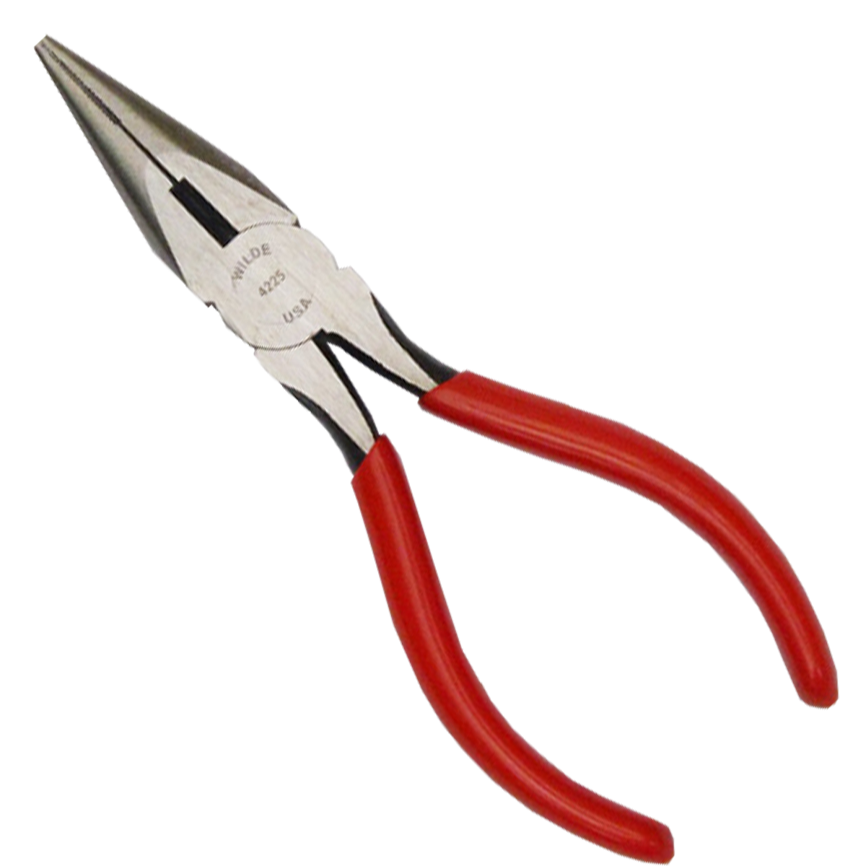
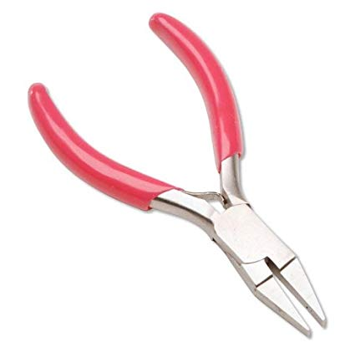
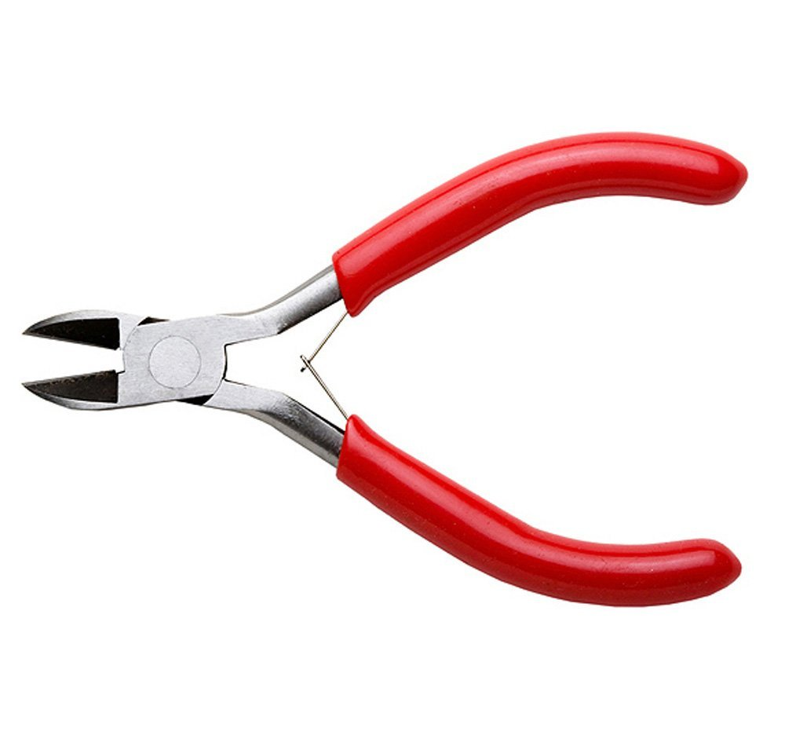
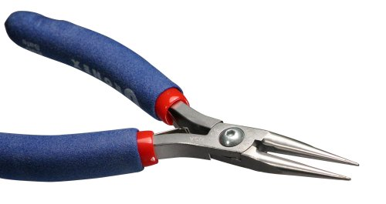
WIRE TOOLS
Flat Nose Pliers
Cutters
Round Nose Pliers
Pliers - Tools that are used to manipulate wire, such as making sharp angles and curves.

Slide 18
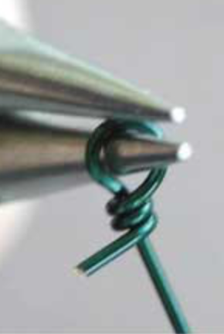
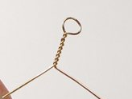
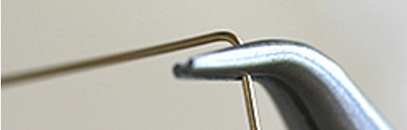
WIRE TECHNIQUES
Twisting/Wrapping - two pieces of wire bound together in a spiral configuration – (covers length of wire)/ one material covers another.
Crimping- uses pliers, squeeze the wire tight – also used to place a sharp angle into the wire.

Slide 19
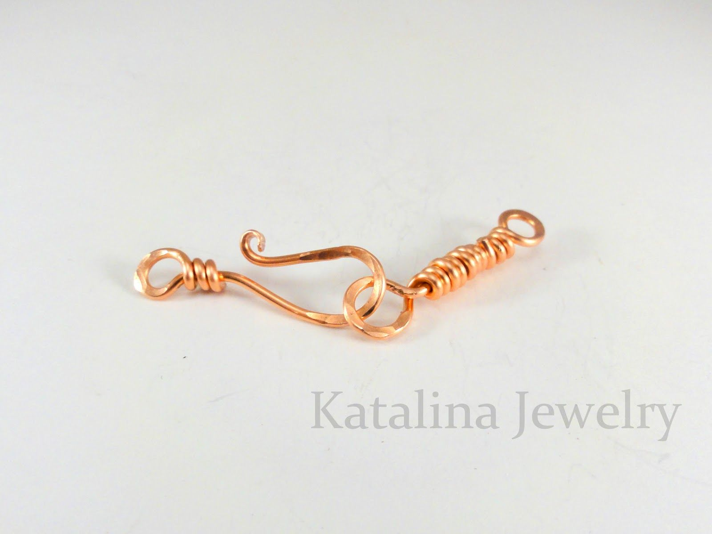

Slide 20
WIRE TECHNIQUES
Hook and Eye – a hook that inserts into a circle

Slide 21
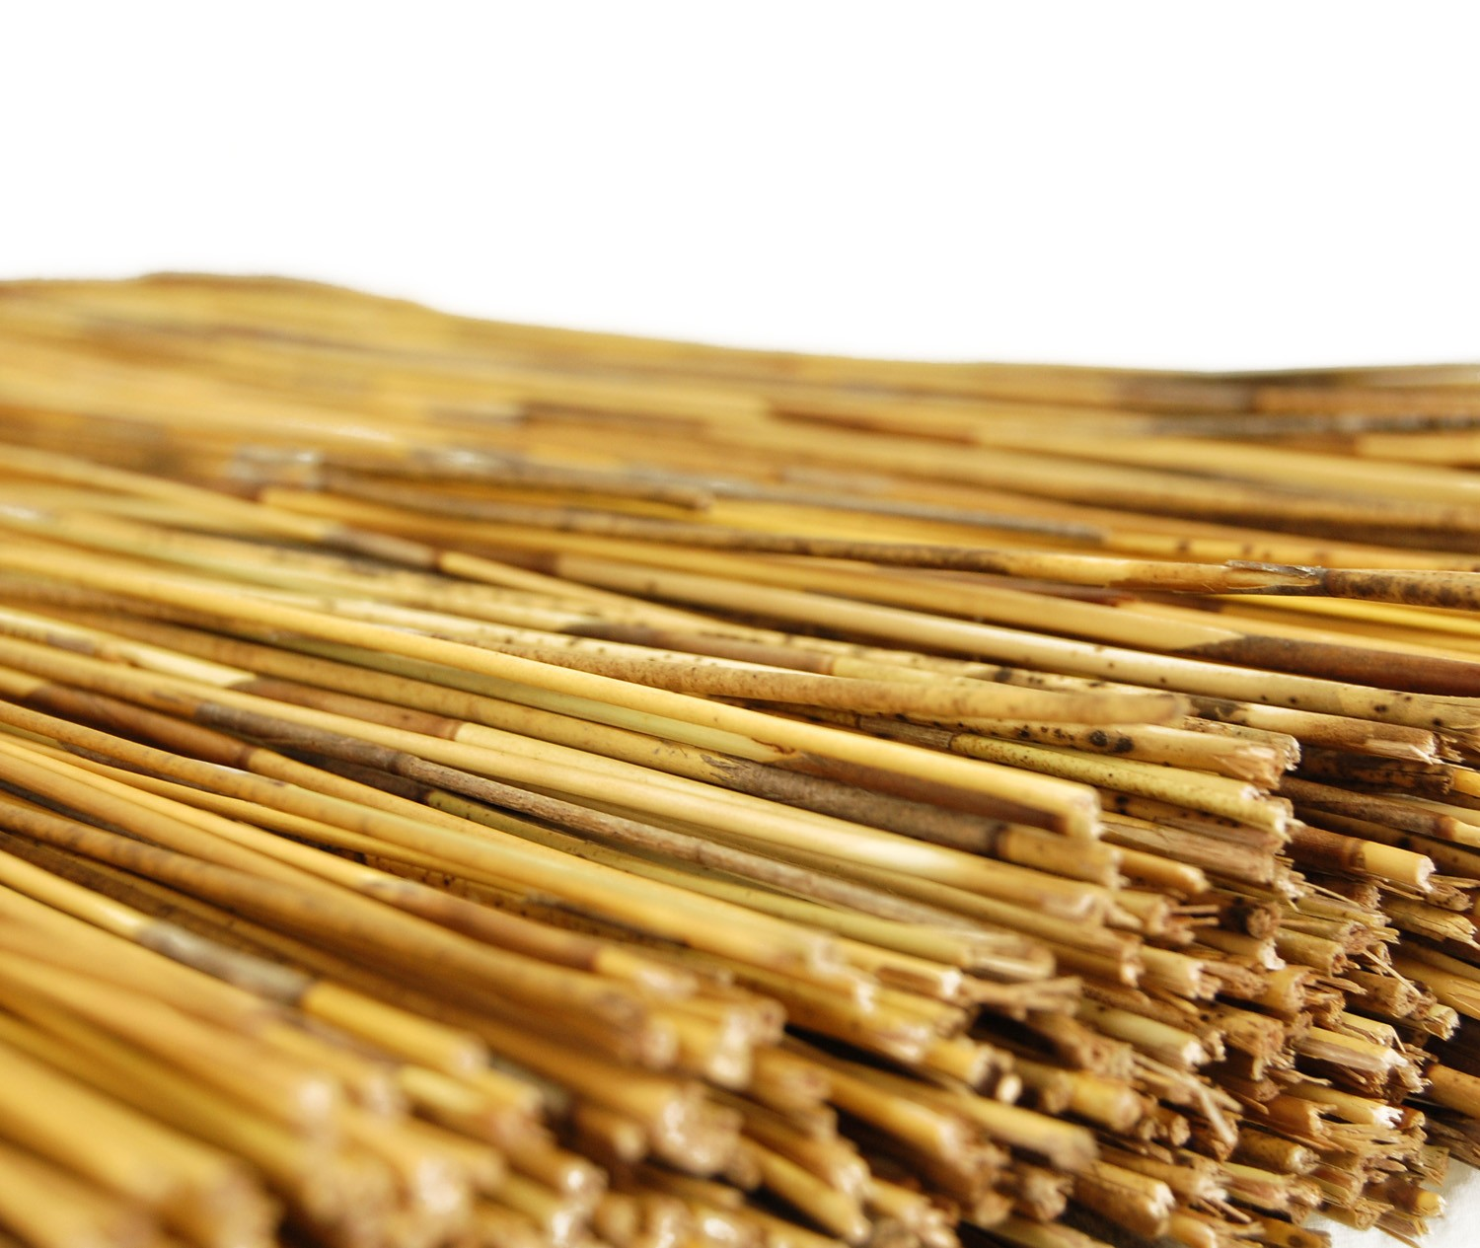
REED
A tall, slender-leaved plant of the grass family that grows in water or on marshy ground.

Slide 22
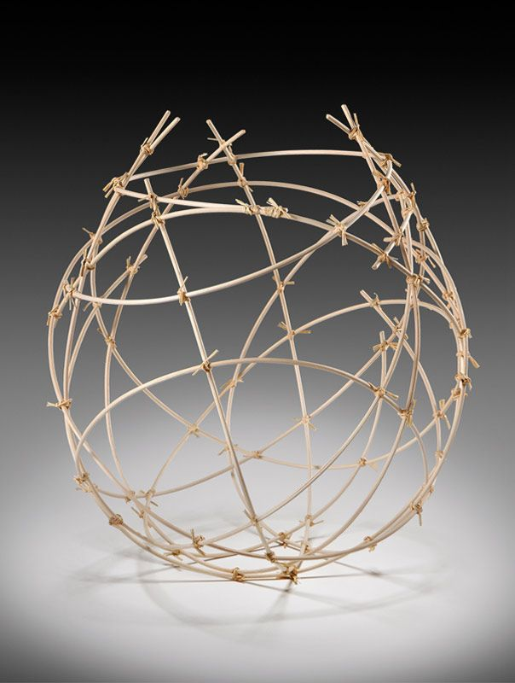
Wet Reed
Soak reed for an hour or more to make fiber more flexible.

Slide 23
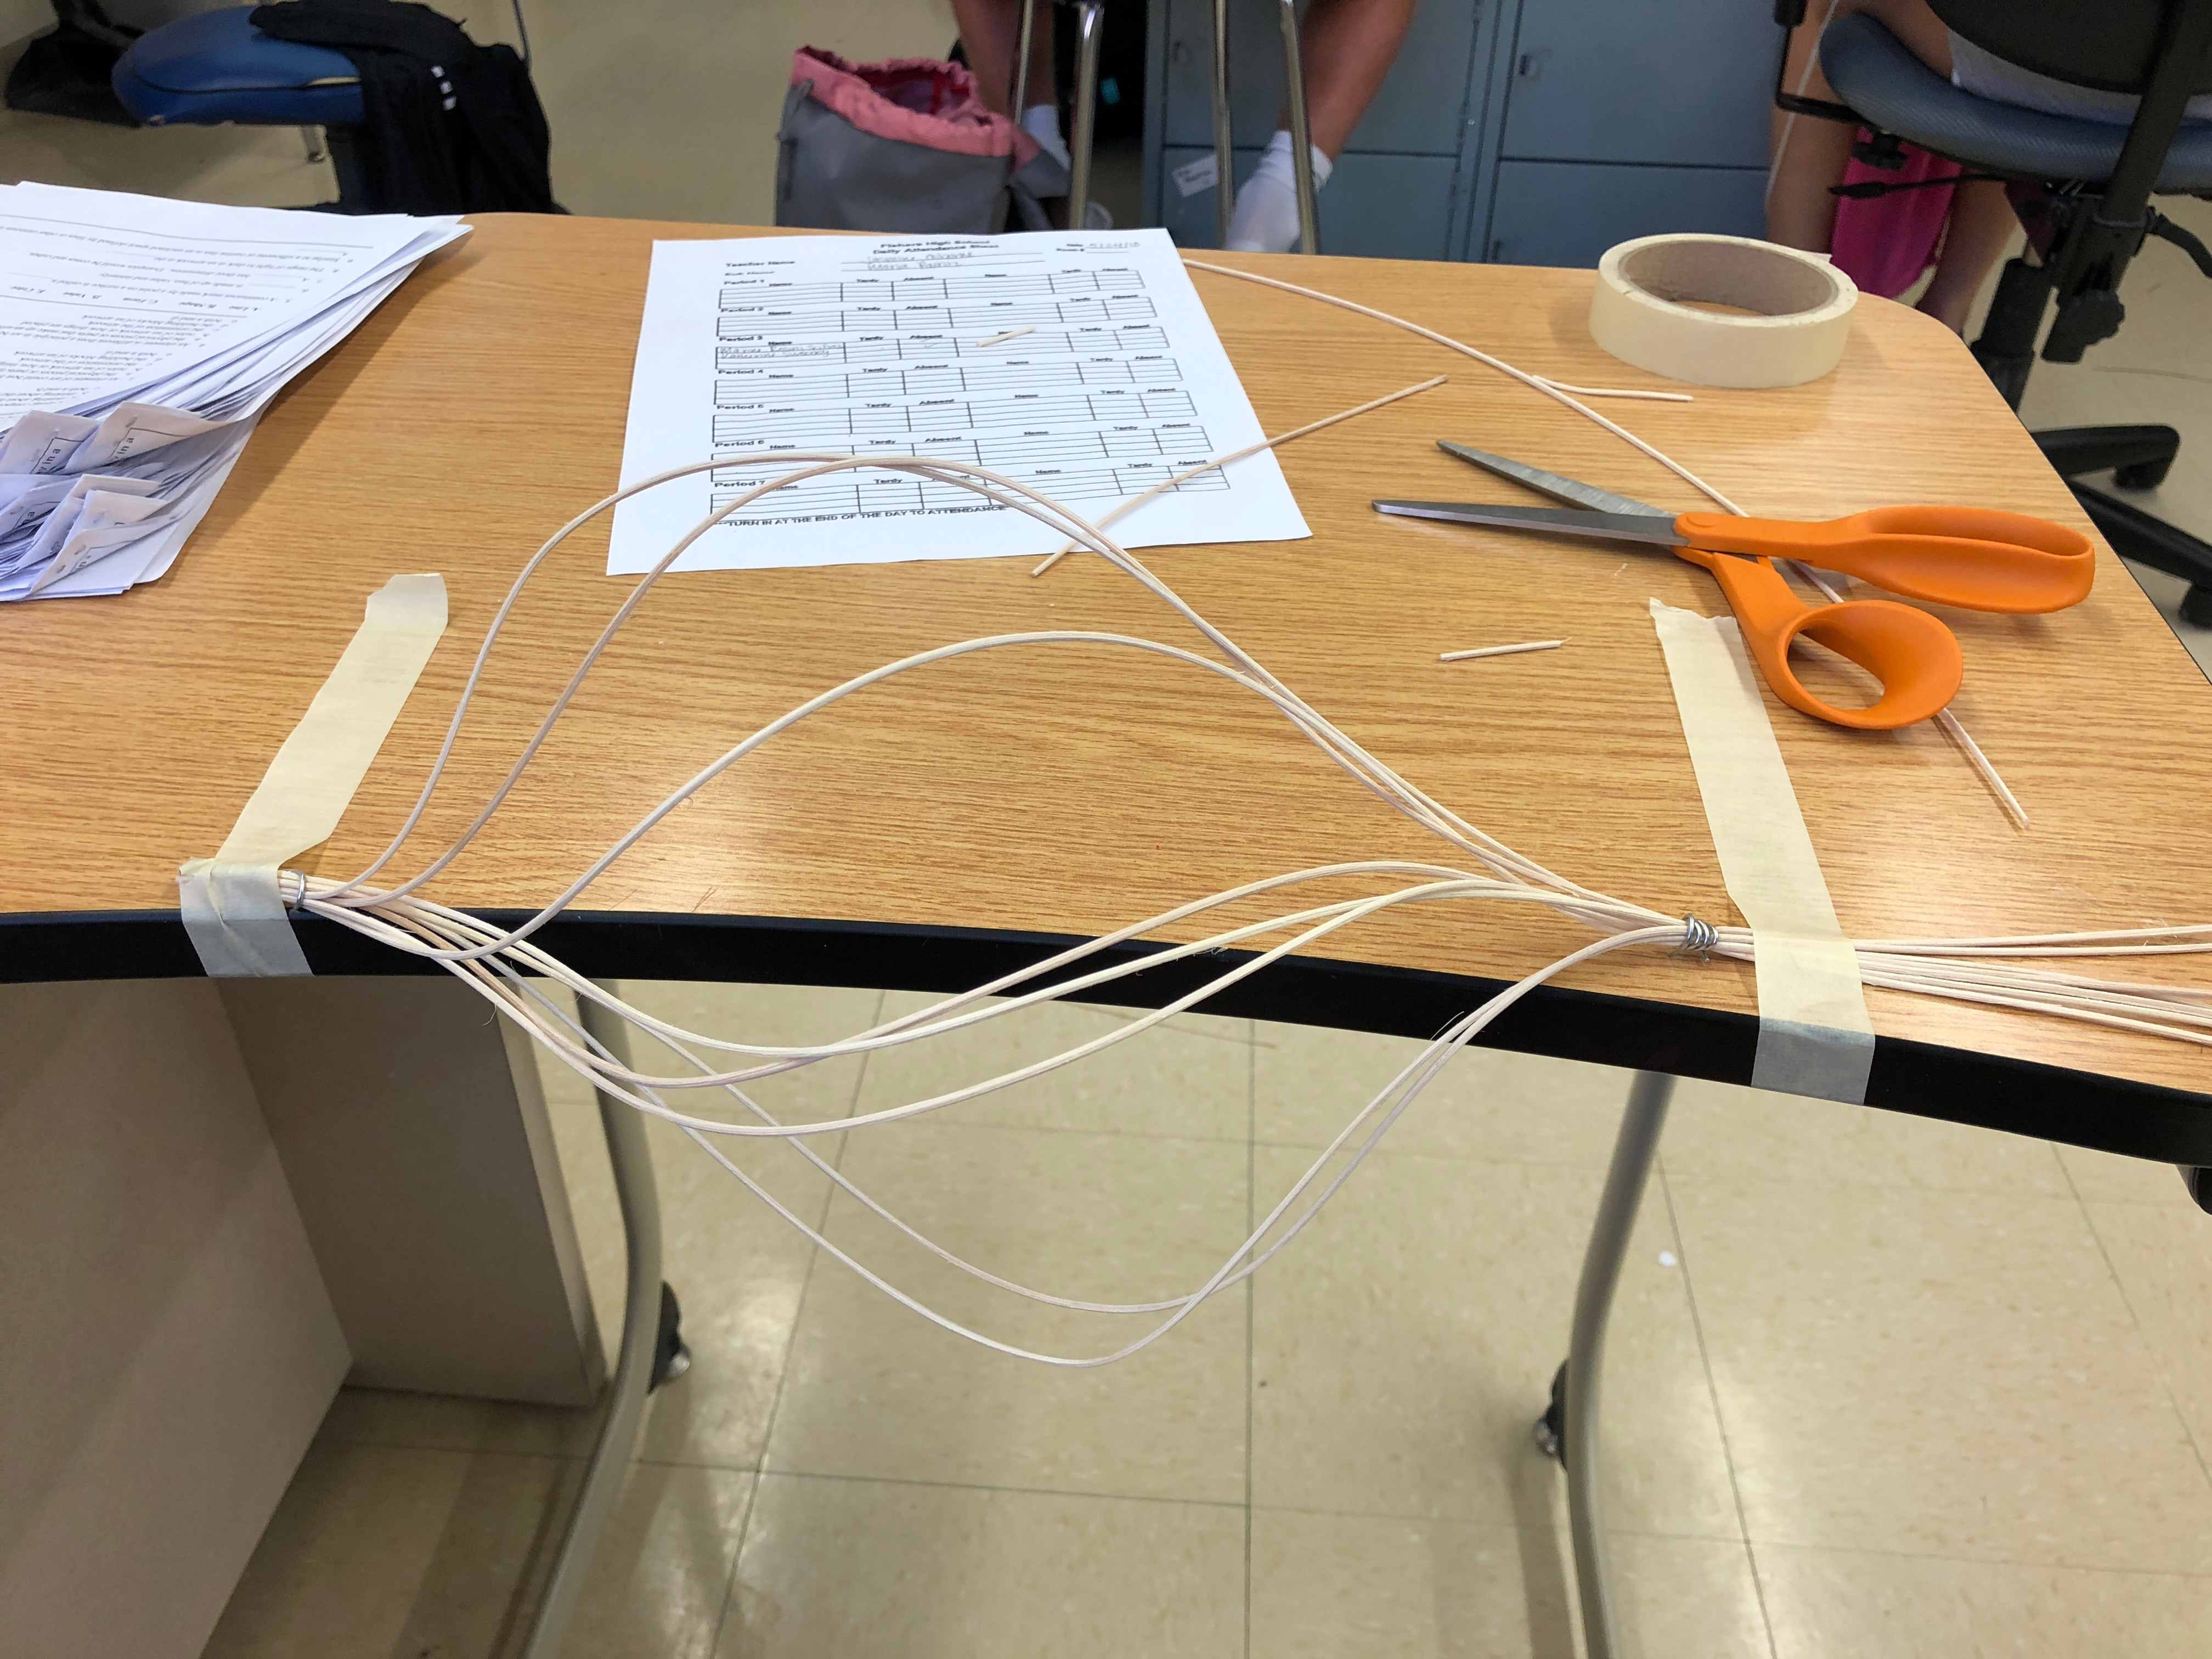
Shaping Wet Reed
Once you have bent the reed in the shape you want, tape it down, or reinforce it in some way to stiffen overnight.

Slide 24
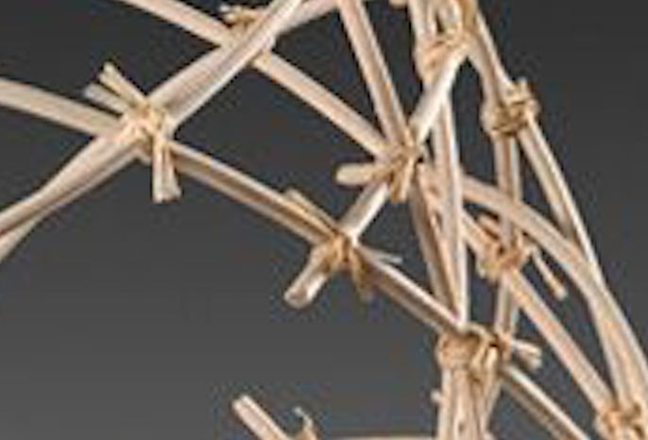
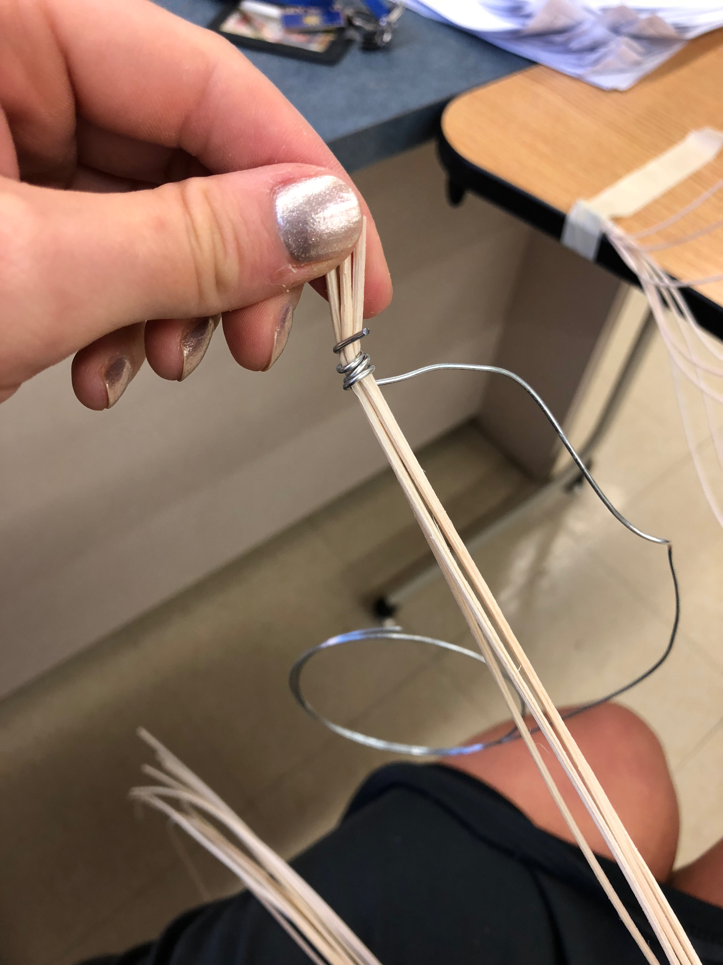
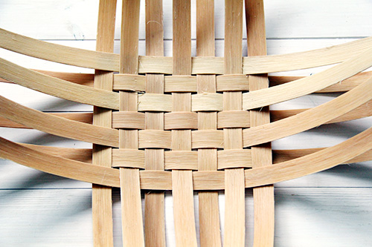
Connection Techniques
Knotting
(Overlap) Wire Wrapping
Weaving

Slide 25
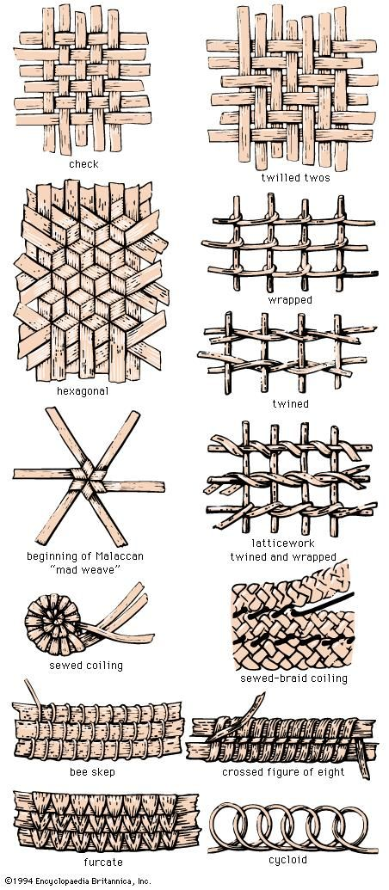
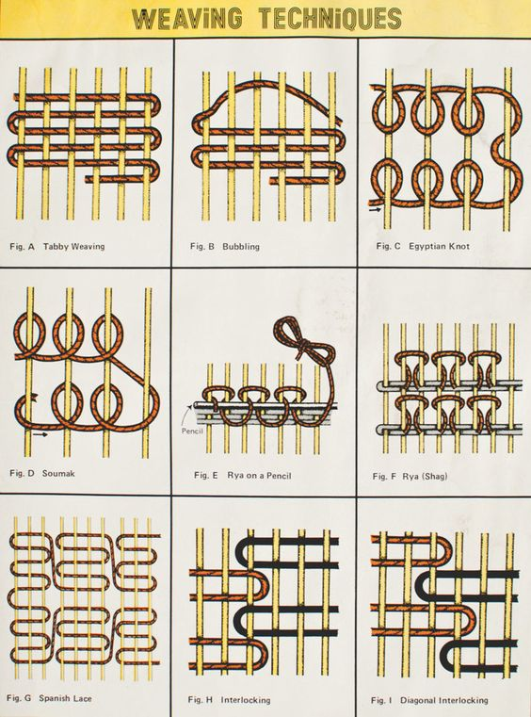
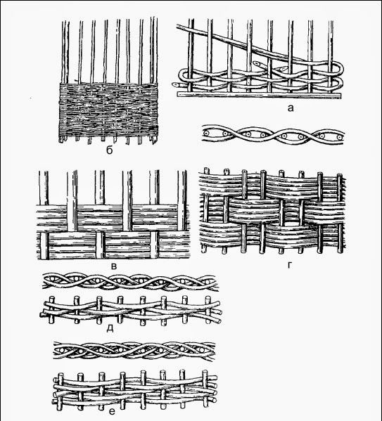

Slide 26
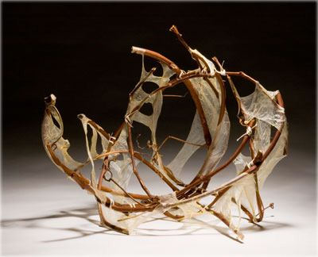
Connected by use of Tissue & Mod-Podge (Glue)
String

Slide 27
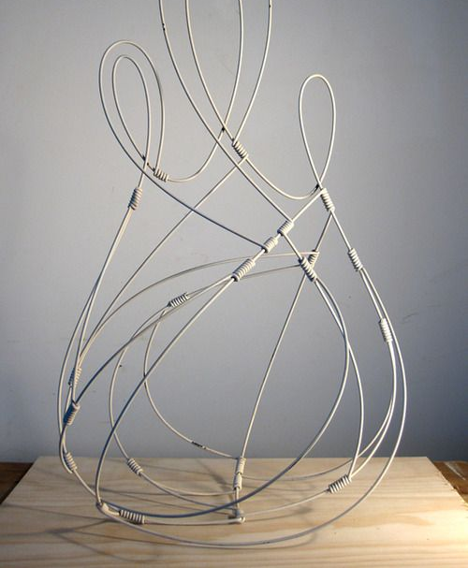
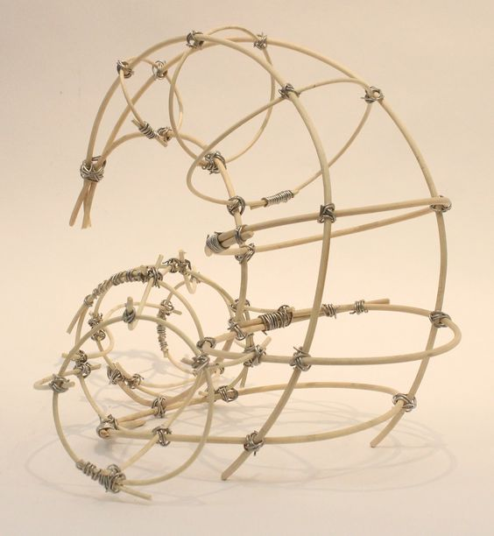
Reed connected by wire.

Slide 28
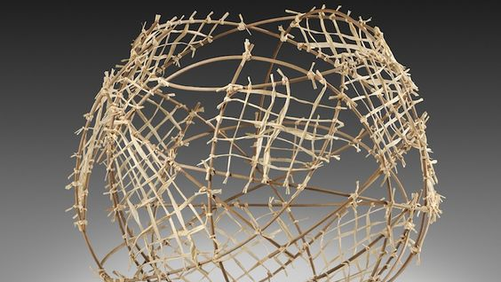
Connected by String & Thin Reed (Soaked)

Slide 29
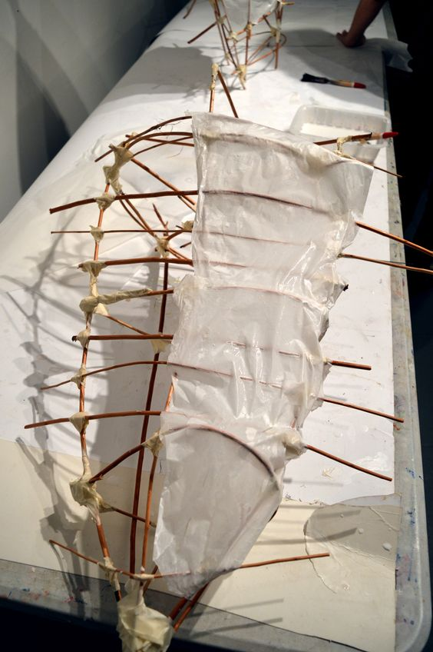
The joints (intersections) of the reeds are held together through the use of masking tape because they are covering the connection with tissue paper.
You could also use hot glue, IF the connection isn’t going to show

Slide 30
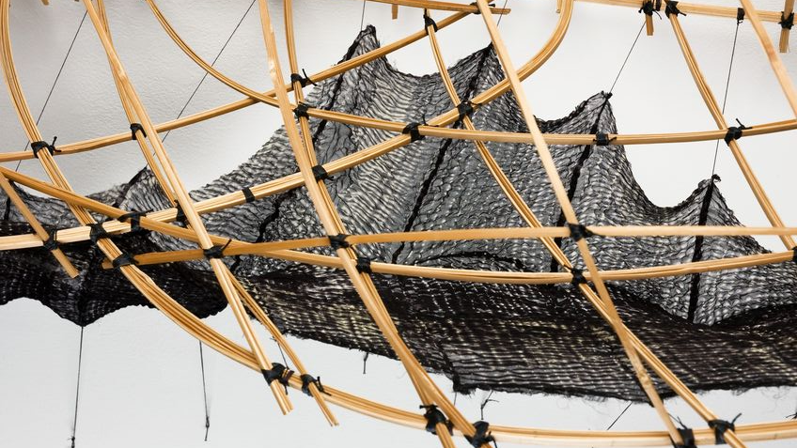
Thin Wire or String

Slide 31
CONCEPTUALIZING
YOUR SPIRIT POD

Slide 32
DESCRIPTIVE WORDS
Write a list of words that you think describe your spirit/character. Begin drawing different lines for each word that visually describe that word.
Visit this site if you’re having trouble thinking of words.

Slide 33
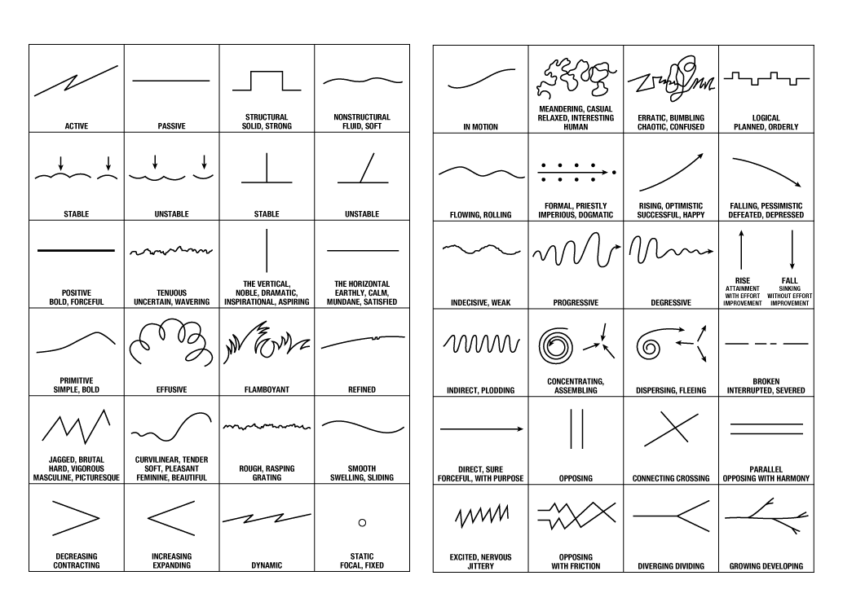

Slide 34
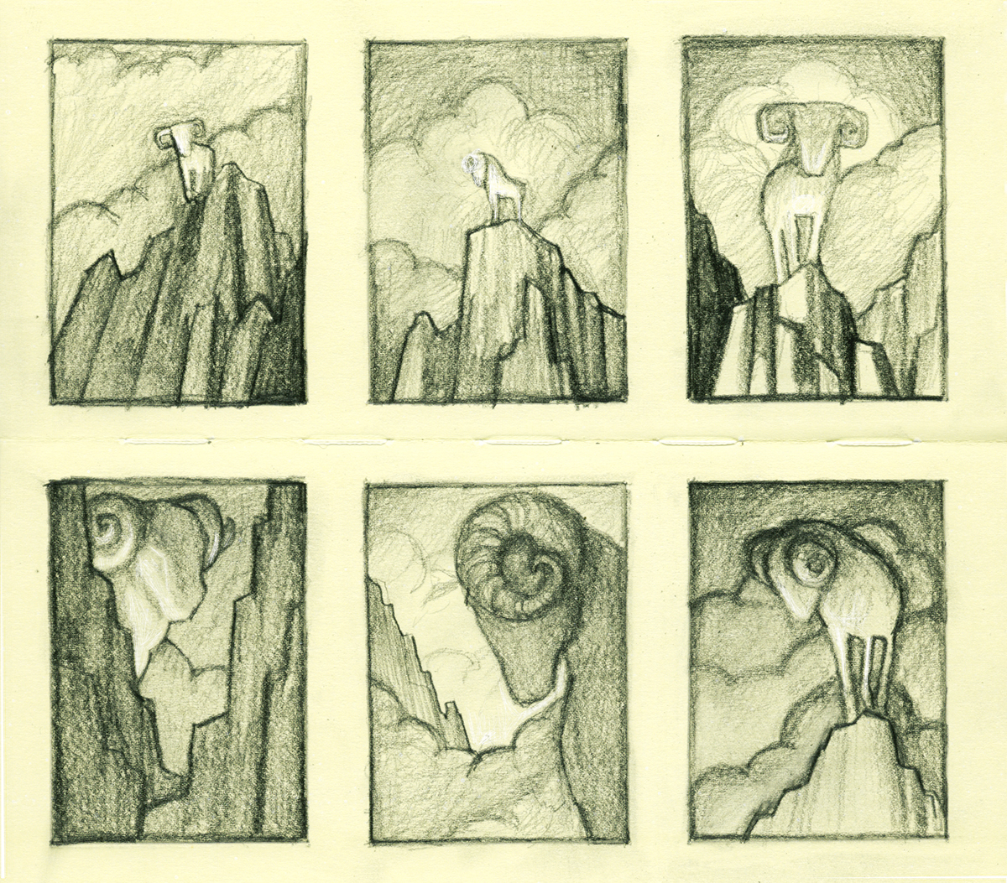
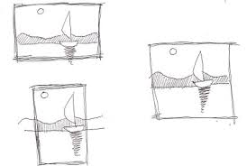
THUMBNAIL SKETCHES
Thumbnail Sketches - a small drawing used to explore multiple ideas quickly.

Slide 35
WHY THUMBNAIL SKETCHES ARE IMPORTANT
Allows quick exploration of multiple, unique ideas.
Reduces overthinking.
Freedom to design without worrying about technique.
Avoids artist block.

Slide 36
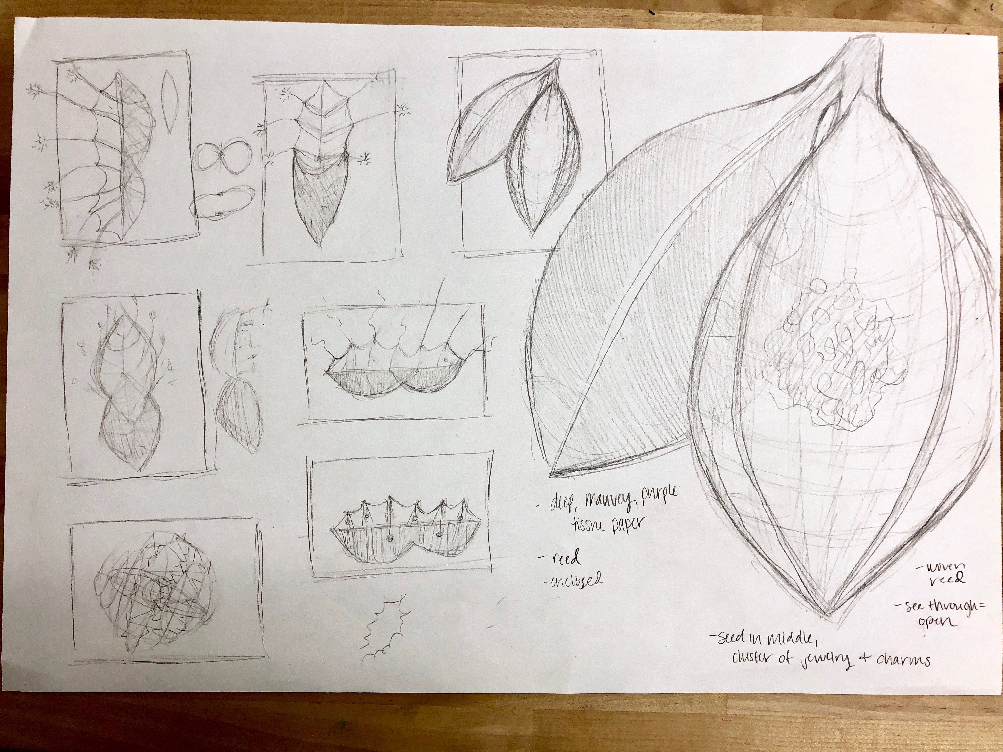

Slide 37
THUMBNAIL SKETCHES
Create 3-6 thumbnail sketches exploring different compositions.
Complete at least 1 larger, more detailed sketches of your finished product. Include annotations on dimensions, materials, techniques, etc.

Slide 38
IDENTIFY BUILDING TECHNIQUES/ORDER
On the final sketch of your project on your vision board label what order you will need to build your sculpture.
You need to demonstrate at least two connection techniques in your final piece.
These can change as you begin working, just have a plan in mind before you start constructing.

Slide 39
CREATING
YOUR SPIRIT POD

Slide 40
TIMELINE
You will have 2 weeks to construct your sculpture. Make sure to pace yourself so you do not finish too early or are not finished by the end of two weeks.
I will adjust the deadline based on overall progress in class.

